Slide 1
Mobile Phone Breathing Detection
Brain Music Lab
Lyn Phan

Slide 2
What is this thing?
A self calibrating breathing detection app built in Unity designed for mobile phones.
Hooray science!

Slide 3
Where did this come from?
The original concept came from Spring 2020 Project Studio final project.
A peak detection-based breathing detection algorithm was used as a part of it.

Slide 4
How did it work?
Computation was done on a computer within a Max patch.
Data received via UDP using an app called TouchOSC.
TouchOSC can gather and send all kinds of data, including accelerometer data in this case.
Accelerometer data can be generalized to the form of a vector <x, y, z>, where each value is between -1.0 and 1.0, denoting orientation
These values arrive together with TouchOSC and UDP, but this isn’t the case when working in Unity.

Slide 5
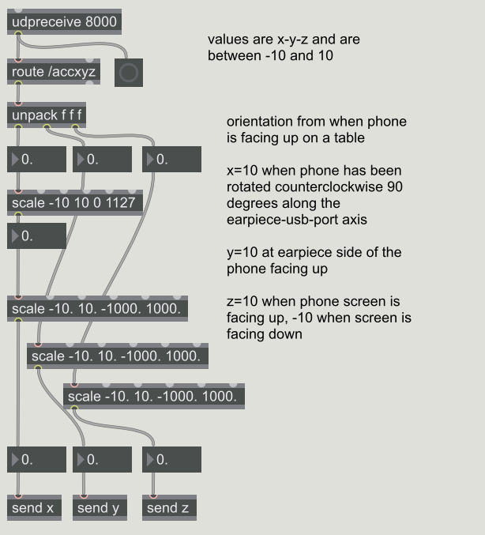
This part of the Max patch receives the data over UDP and scales the data to be read by the rest of the patch.

Slide 6
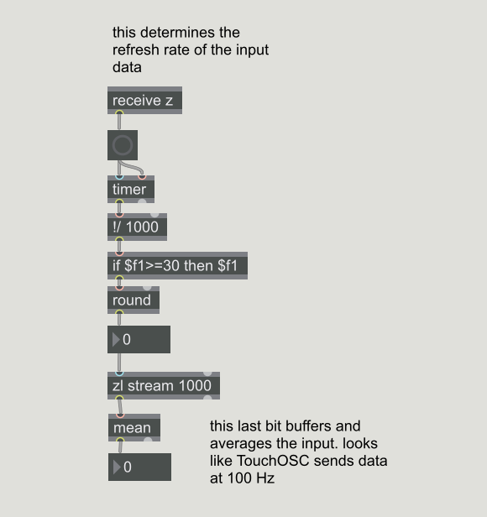
This part of the Max patch calculates the sample rate of the data stream, allowing for an operator to manually calculate values using it.

Slide 7
How did it work?
Peak detection on the accelerometer data was performed using two buffers of data samples.
One “short” time buffer and one “long” time buffer.
An average vector is computed between the short and long buffers.
The two averages are compared and differences passing a threshold are flagged as peaks.
Denoising is performed to prevent false positives.
Using a short buffer rather than a single vector for the current position reduces random spikes.
Setting a time delay between peak flags prevents the same event from getting flagged twice.
Confusing yet?

Slide 8
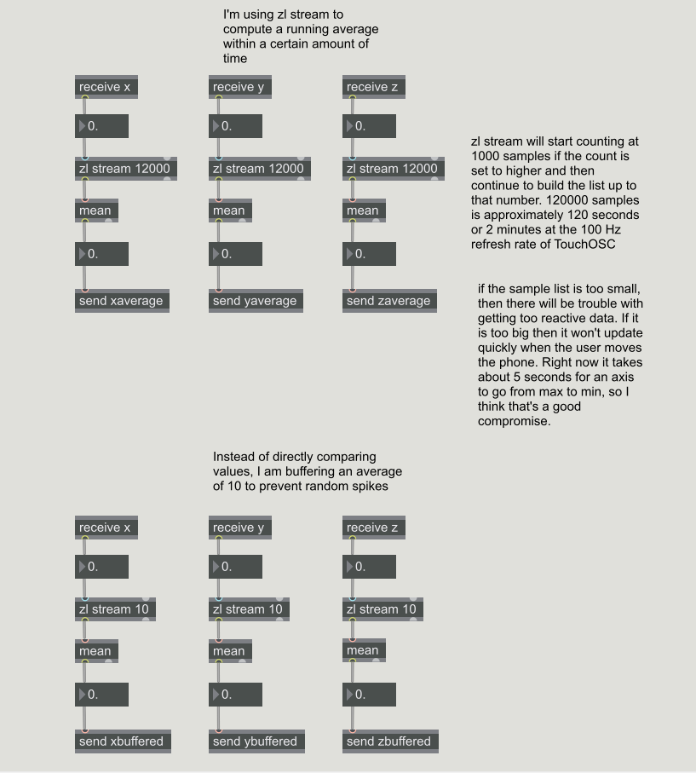
In the Max patch these were the two blocks that formed the two buffers to be averaged.
Note that the long buffer uses a stream of 12000 samples and the short buffer is only 10 samples.

Slide 9
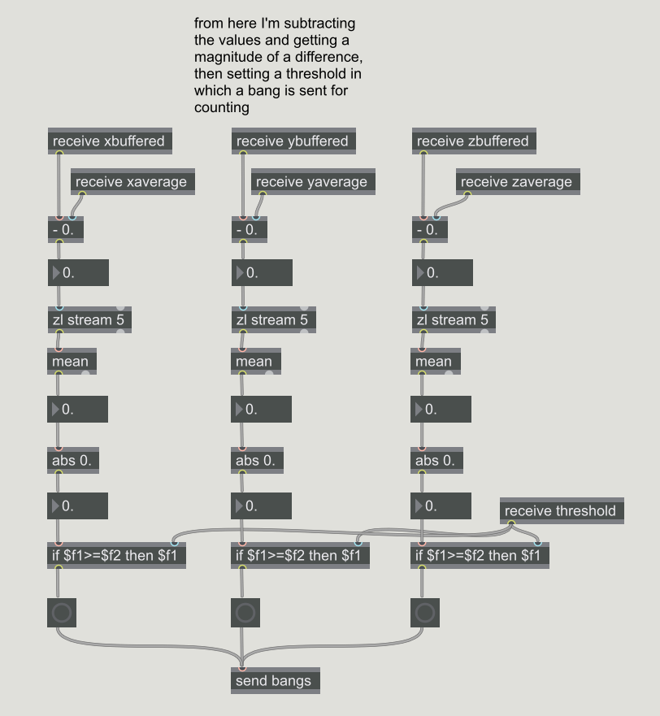
In the max patch this was the block that compared the averages of each value in the short and long buffers each frame.
Note that the differences calculated between those two averages were also placed into a very short buffer and averaged, again to reduce noise.

Slide 10
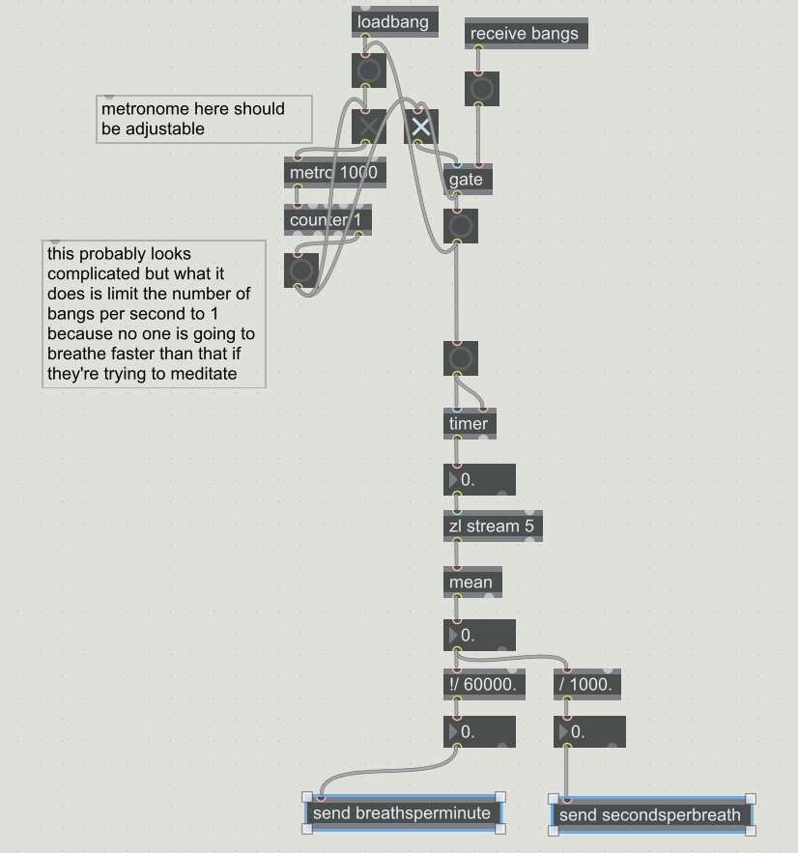
The top half of this block denoises the stream of peak data by only allowing a peak signal pass through once every 1000ms (which can be adjusted).
The bottom half calculates a breathing rate by timing between received impulses and averaging the time between them to calculate a breathing rate.

Slide 11
Benefits of using this method
Once tuned to a device, the detection is reliable and self calibrating to different positions.
The use of buffered averages rather than absolute positions allows for the device to move along with a person, and quickly become ready again without user input.

Slide 12
Issues with this original version
All phone hardware and people using it are different.
Though designed to self calibrate to position changes, the original version did not have a way to self calibrate to devices or people.
Threshold values for individual phones needed to be calculated and added to the Max patch by hand.
Requires two devices to run.
A computer running Max/MSP and a mobile device running TouchOSC, both of which are closed source and require paid licenses.
Operation requires directly manipulating the Max patch and TouchOSC’s settings, especially for first time setup, resulting in more user error.

Slide 13
Any Questions So Far?

Slide 14
Options for a New Platform
Native Android.
Limited to one operating system.
Relatively slow to prototype.
Not cross platform.
Not super friendly to noncoders who may have to edit parameters later.
Lots of documentation for general purpose apps.
Native iOS.
Same issues as android except I would be further limited by Apple’s device and developer limitations
Unity?

Slide 15
Why Unity?
Cross-platform support for both iOS and Android.
User interface is easier to set up for different platforms all at once.
Performance tradeoffs for non-native code can be negligible if code is written efficiently.
Faster prototyping.
GUI based app design, with C# for most backend scripting.
Makes it much easier for someone unfamiliar with code to modify the program.

Slide 16
Why Not Unity?
Non-native UI appearance for different operating systems.
I’ve standardized on Android fonts and sizes for now, but the app may look a little out of place on iOS.
Loops within scripts act only once per displayed frame, so only 60 samples per second
Being sloppy with code efficiency can drop the framerate due to performance reduction.
App size slightly larger due to required Unity libraries.
Since Unity is a game engine, most documentation is oriented toward game development.
Unity isn’t perfectly cross platform so porting may still have to be done due to the way OS filesystems work.

Slide 17
Rewriting into Unity

Slide 18
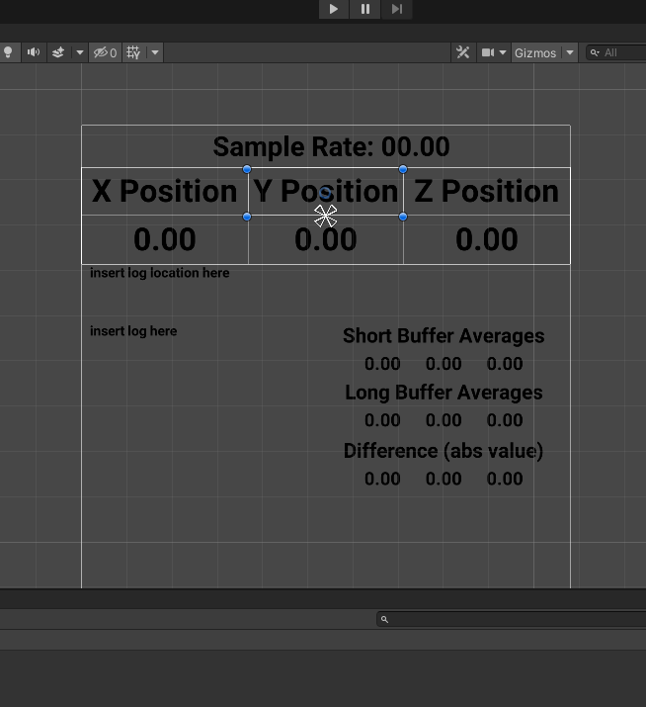
Here we can see the relatively simple way that UI can be set up with constraints based on a window.
This is from much later in the timeline. At the beginning I only had the sample rate and position displayed.

Slide 19
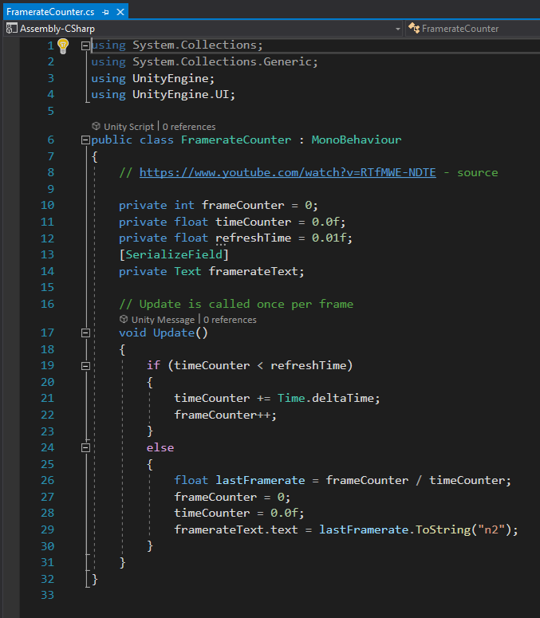
First order of business: a frame rate counter so we can get a sample rate.

Slide 20
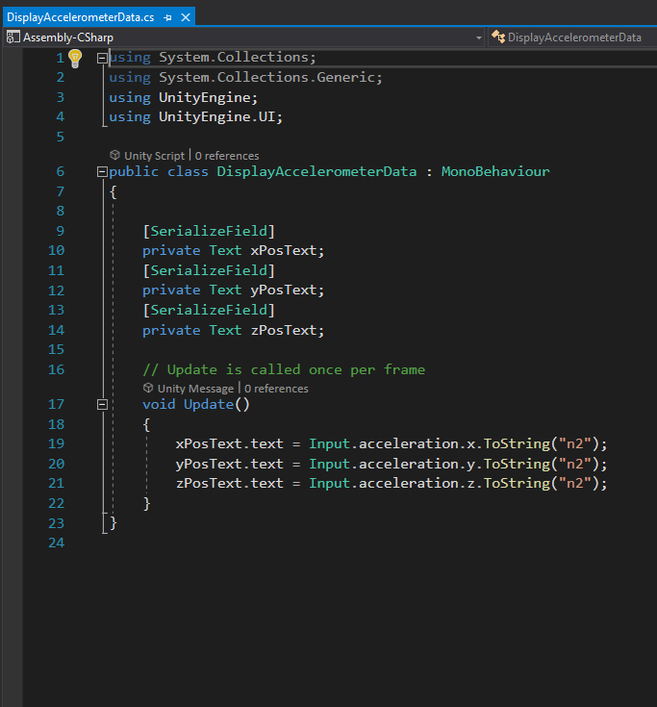
Second order of business was displaying accelerometer data.

Slide 21
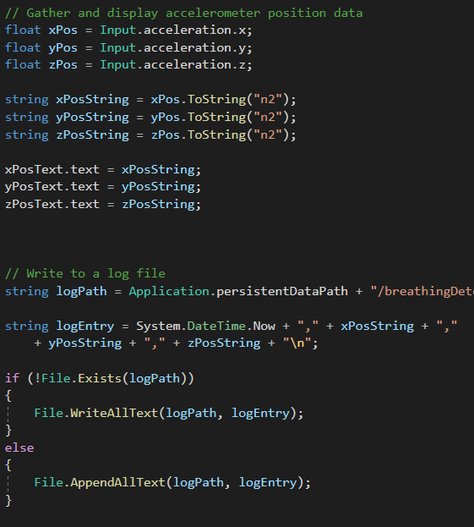
Eventually figured out that I could write the values being displayed into the log directly.

Slide 22
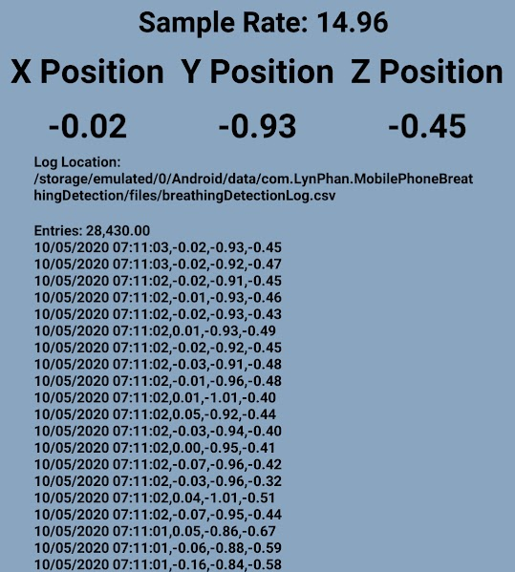
Testing implementation of displaying a log.
Issue: sample rate dropped drastically as log size increased as it was read every frame.

Slide 23
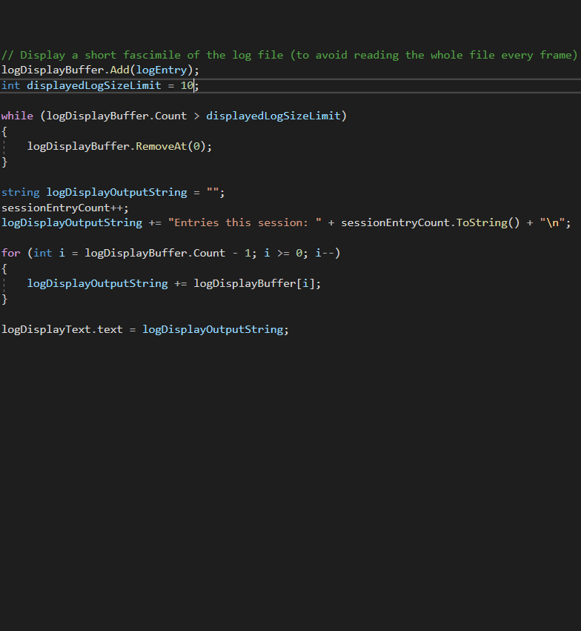
Efficiency issue caused by file being read constantly, can avoid reading it by making a short buffer to read from instead.
Pros: speed
Cons: memory usage

Slide 24
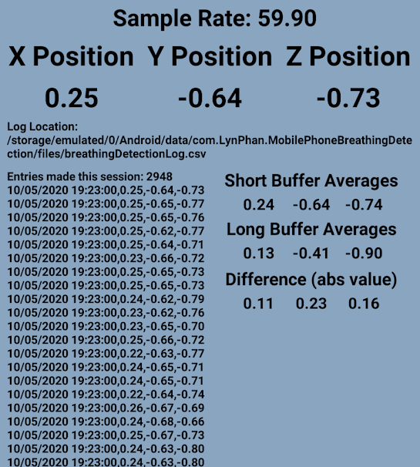
Sample rates improved instantly after switching to using buffer of values to display rather than reading from file.

Slide 25
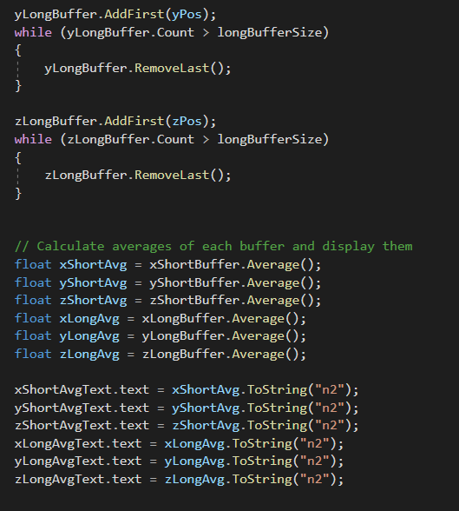
Since I was already able to log data as well as make a specific-sized buffer, it was trivial to implement the six buffers to count the accelerometer values.
For now the buffer lengths are set to 12 and 1200, which at 60/sec sample rate is .2 seconds and 20 seconds.

Slide 26
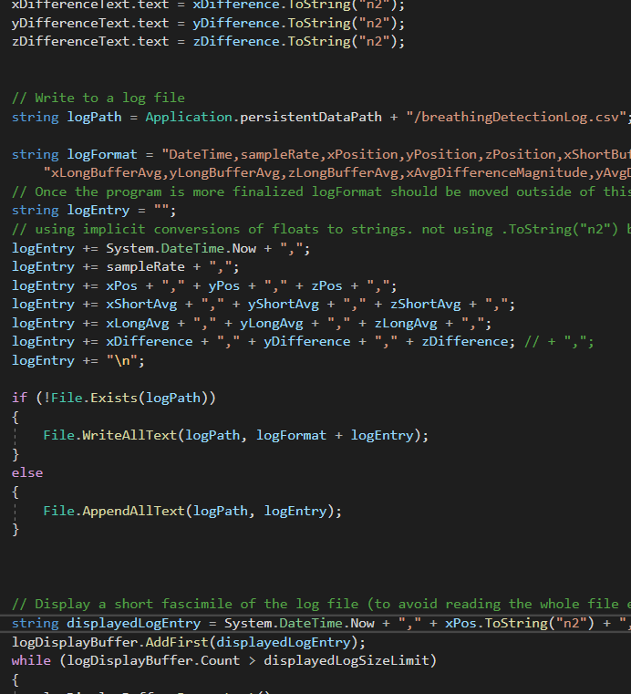
In the middle part here we see the way that every numeric value so far is added to the log.
This allows for comprehensive logging and here we can use the most precise value given by the hardware.

Slide 27
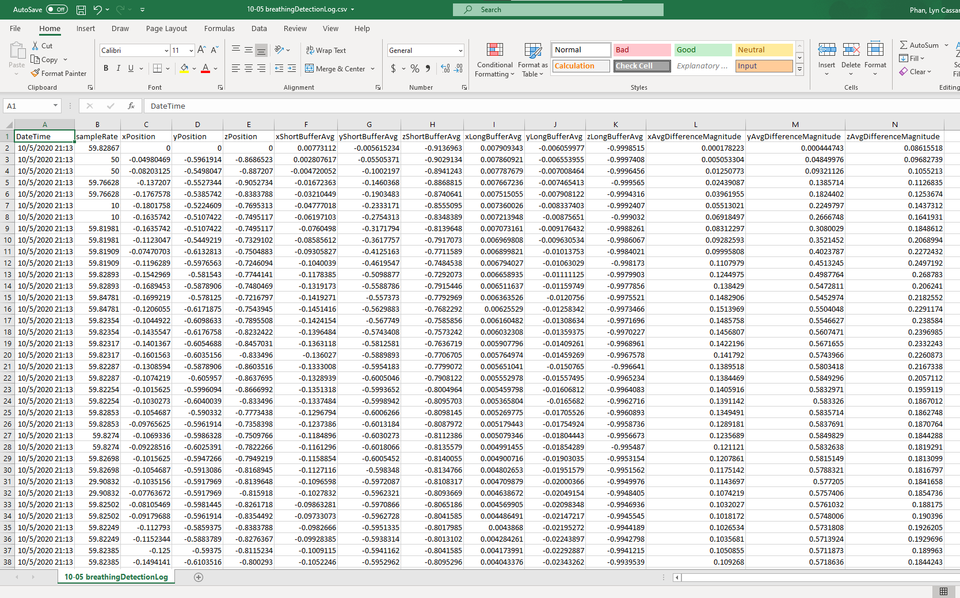

Slide 28
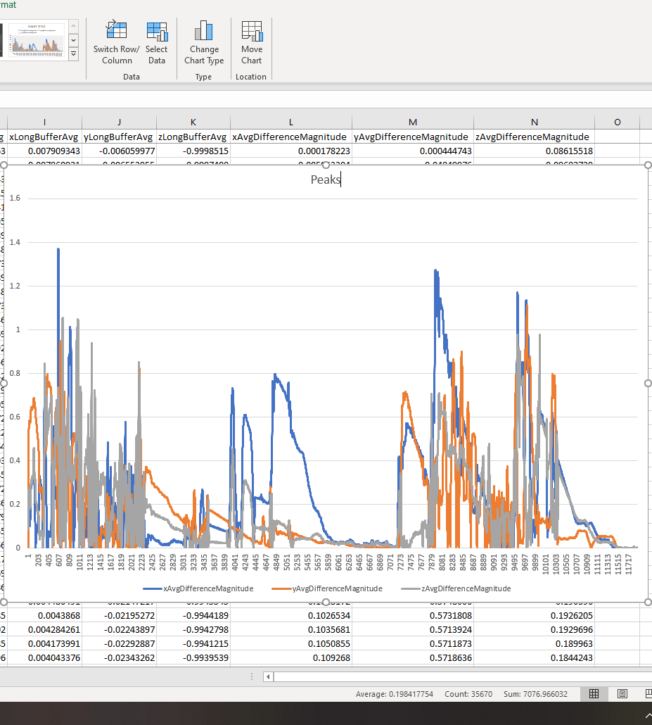
Using excel we can easily see the peaks based on the average distance between the short and long buffers
This example was just waving the phone around, but this is of course going to be most effective for observing periodic signals

Slide 29
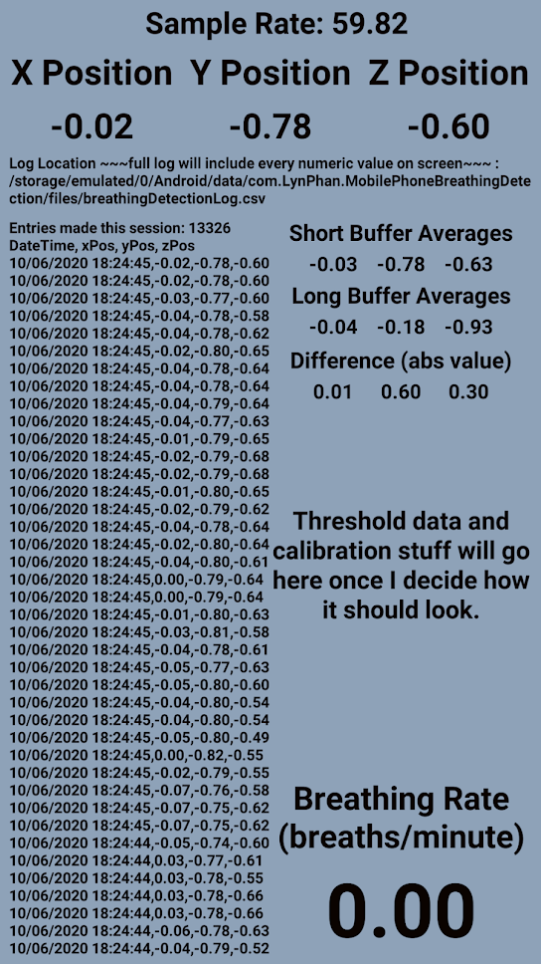

Slide 30
Main Challenges so Far
Lack of documentation for general purpose apps in Unity.
This especially includes the minor differences between operating systems, such as how Android Unity apps can’t write to their own installation “directory” and need separate data storage.
Efficiency, since mobile phone processors are still quite weak compared to even laptops.
Frame rate issues can result from GPU bottlenecking as well, which happened if I tried to make text too small.
Most features were in separate scripts that ran every frame, but I refactored them all into one script to reduce as much overhead as possible.
Making an interface that’s both legible and functional.

Slide 31
Where are we at now?
Milestones:
Hello world.
Retrieving + displaying sensor data.
Data logging.
Implementation of self calibrating breathing detection.
Implementation of denoising.
Implementation of automatic calibration to hardware.
Documentation.
Preparation for passing the project to another person.

Slide 32
What next?
Immediate next steps
On-device peak detection and breathing rate calculation.
Finding more devices to test on.
Tentative timeline.
Week of 10/12 and 10/19
Implementation of breathing detection.
Week 10/26 and 11/2
Implementation of automatic calibration to hardware.
Week 11/9, 11/16, and 11/23
Documentation and spillover for earlier delays.
Week of 11/30 and 12/7
Prepare the project to be passed on to someone else.

Slide 33
Questions?

